Slide 1
Using Social Media to Promote and Grow Your Art Program
Charity-Mika Woodard
Notes:
Back in the day we hung up art in our rooms, the school hallway, or maybe the Cafe-agym-atorium, the only people whosaw it would be our fellow colleagues and the occasional parent.
Fast forward till today- You can post a picture and hundreds of people will see it and instantly know what is going on in your art room. Great resource but also great responsibility.
Let me help you harness this power and use it for good!

Slide 2
Why use Social Media
Stay connected to other art teachers
Share the value of Art Education showing that it is a value to the students, the school, and the community.
Be joyful about your job- this noble profession
Share and stay connected with parents
Be a good advocate for the arts
Notes:
What do you want from this experience?
I want to to be joyful, inspired, influenced, and connected.
Such an amazing tool to promote the arts and to share what you are doing in your classroom.

Slide 3
Platforms
Pick your social media site
Notes:
You can’t do them all-People who do them all have fulltime Social Media Managers.
Which ones are you currently using? Try to set up a separate account with those sites- Public Facebook site, or an Instagram site about you as the art teacher.
Keep your private world separated from this public persona (Think of this and act here like you would at an Open House)
You are smiling and happy about your job.- Yes paint spills, but what you are doing is a noble and worthwhile profession. Let people peek behind the curtain.
Pick your favorite Social Media site
Instagram- Visual
Twitter
Facebook
Snapchat
Blog/Website- Blogging takes some time, you should enjoy writing/taking photos/ but you can share lesson handouts and more infromation
YouTube Videos- You should like filming, editing, and uploading videos
Image-Based Platforms: Pinterest, Instagram, Tumblr
“Kitchen Sink” Platforms: Facebook, Twitter
Video Networks: Vimeo, YouTube
Professional, Business-Focused Networks: LinkedIn
SEO and Authorship Platforms: Google+
Location-Based Networks: Foursquare, Yelp
Niche Networks: Reddit

Slide 4
Facebook
79% of adults use Facebook (SproutSocial, 2019)
2.32 billion people and businesses on Facebook in 2018. that is the same as ¼ of the world’s population (Facebook, 2018)
Think of it as the new “Address Book” or online “Yellow Pages”
Highlights everyone’s email address, birthdays, and life events
Great first place people look for businesses, people, community events, and schools
Everyone and every company is on Facebook so it lacks cool appeal
Highly saturated with brands and ads

Slide 5
Instagram
32% of adults use Instagram (SproutSocial, 2019)
500 daily active users and continuing to grow (Instagram, 2018)
Visual format
Allows you to take and share photos instantly, add captions on images and other viewers can comment
Easy scrolling through beautiful and eye catching photography
Photo editing tools are built in
One picture needs to tell the story

Slide 6
Pinterest
31% of adults use Pinterest (SproutSocial, 2019)
1.25 million people use Pinterest every month (Pinterest, 2018)
Visual format
In real life you might of cut a recipe, outfit inspiration, or decorating aspiration from a magazine and pined it with a thumbtack on a bulletin board, this is the online version of that board
You can create different boards to organize your ideas
Great to find ideas and inspiration
Very little social interaction
Topics revolve around: food, fashion, health, crafts, decorating, and weddings

Slide 7
Twitter
29% of adults use messaging apps (SproutSocial, 2019)
330 million active Twitter users every month (Twitter, 2018)
Read format
Short text messages or links to news articles that people can share, reshare, and comment.
This is an instant News source
High volume of messages can be overwhelming and things happen fast.

Slide 8
Snapchat
24% of adults use auto-delete apps (SproutSocial, 2019)
16.4 million people use Snapchat daily (Snapchat, 2018)
App for sharing pictures between friends/followers
The pictures auto-delete after viewing or in 24 hours.
Private
Temporary, doesn’t store photos on your phone so it takes no phone memory
Young and cool
Limited functions and limited audience

Slide 9
Website/Blog
You can control the content
The content is always there and can be linked on other social media sites
Can include downloads such as handouts and lesson plans for other teachers
Must enjoy writing, taking photos, and creating content
Free and paid sites, you can always upgrade to a paid site after getting started with a free or trial version
Must build your own audience

Slide 10
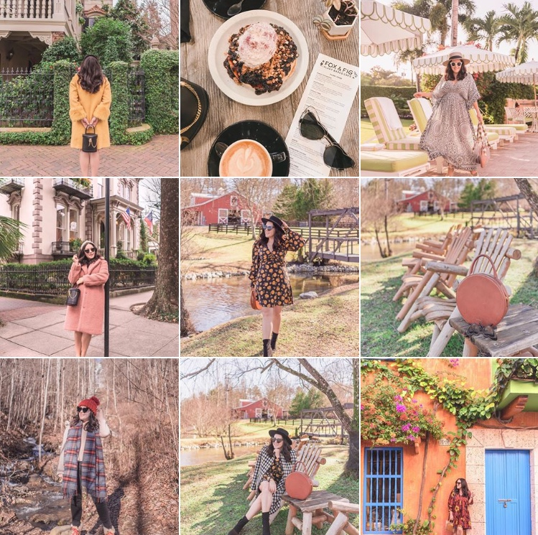
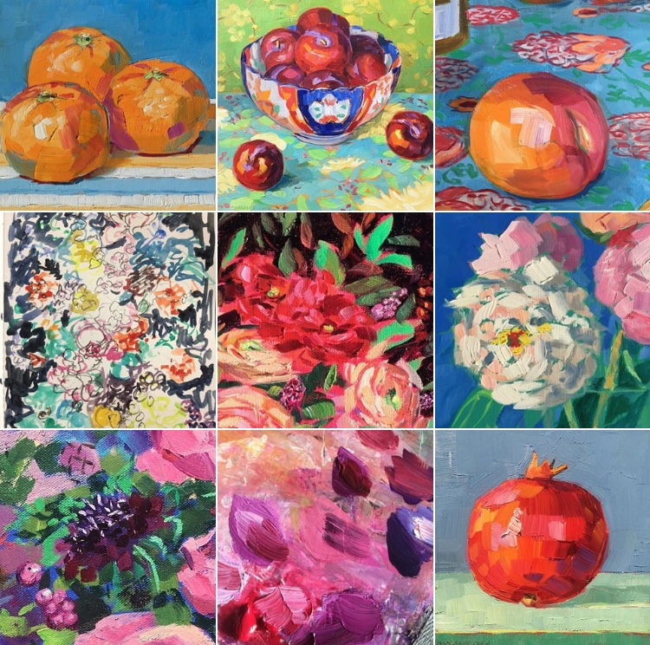
Branding
Notes:
People should know that it is you!
Color scheme?
A “look”
Look at your top photos on any social media site- do they look like they go together or are they random? A picture of a cat, the food I ate for lunch, us getting on the plane at the airport, etc.
Think about self editing that down to tell a story with a “signature look.”
Also remember- this is a separate professional account- not the place for pictures of your new grandbaby and your cat.
Pay attention to what gets a response- if your picture only gets 4 likes- that’s not your brand. Every once in a while declutter your social media site, delete some of those pictures that aren’t on brand and didn’t get many likes “Pulling the weeds”
Color- like blue and Yellow- look for those colors when you take pictures
Filters- use the same filters every time

Slide 11
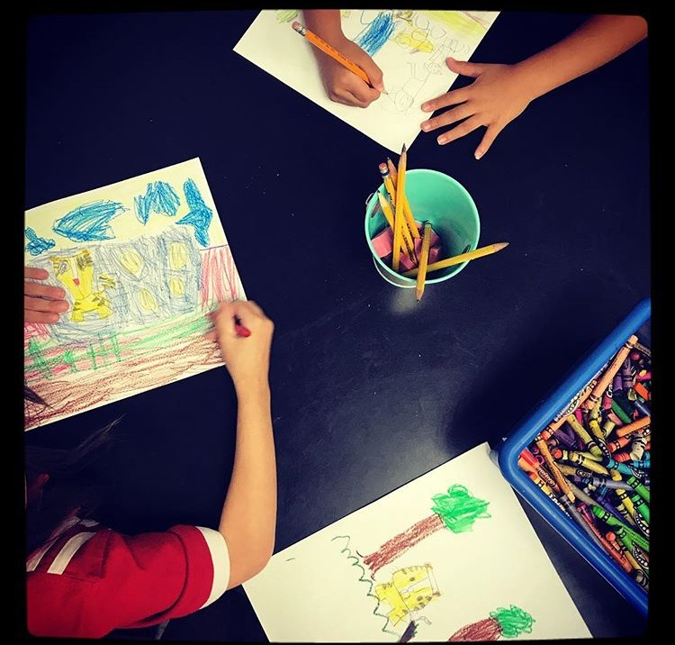
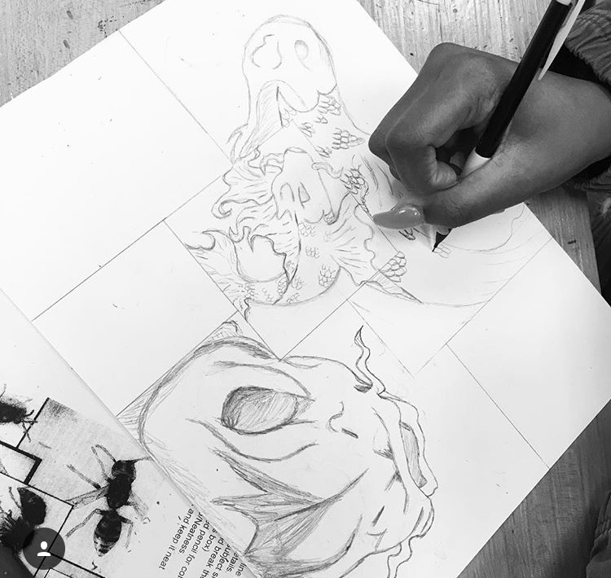
Make sure you have permission
School Law 101
Notes:
Make sure you have permission, or go around it with filters and tricks

Slide 12
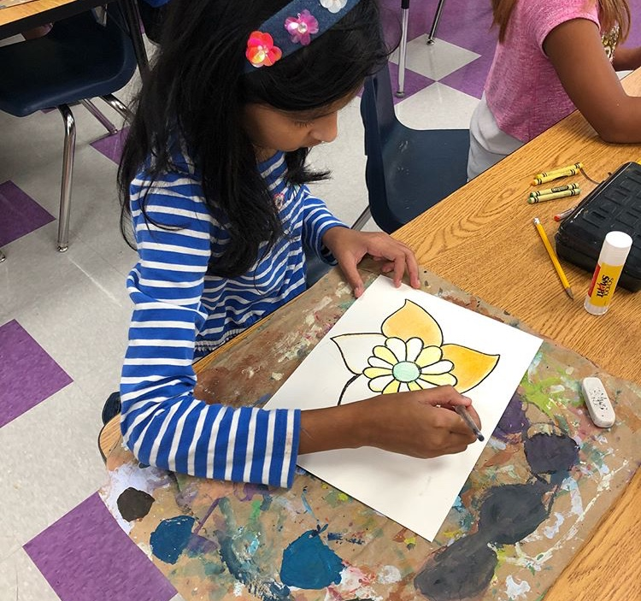
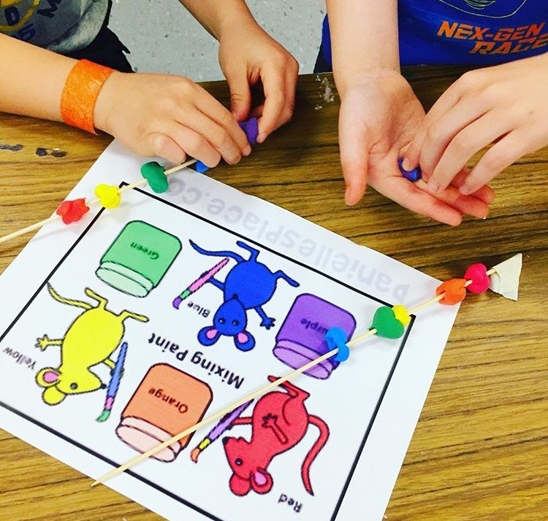
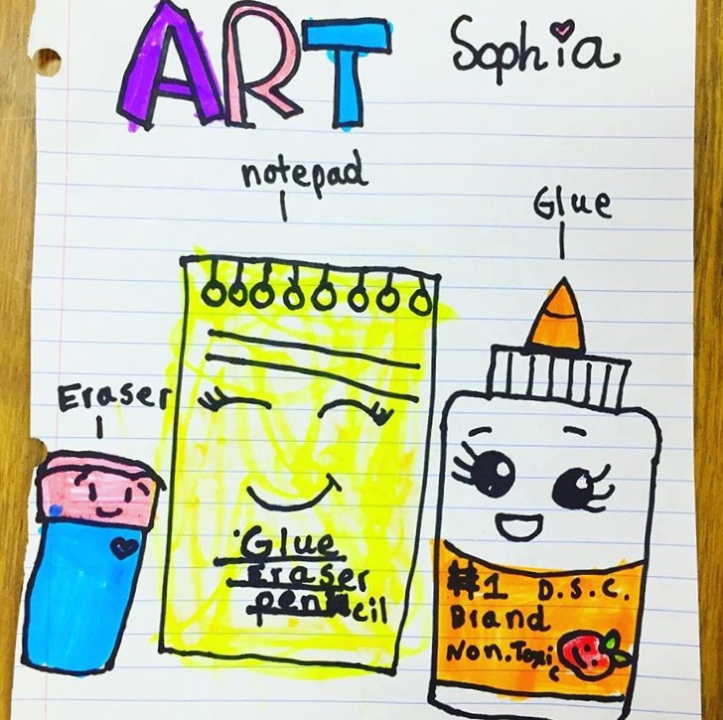
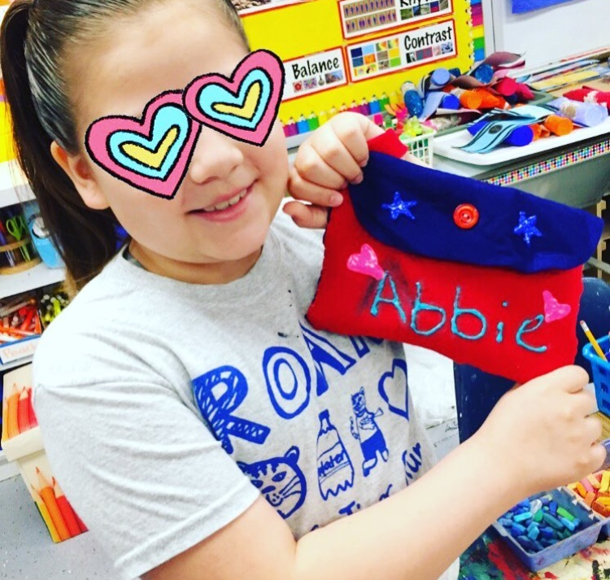
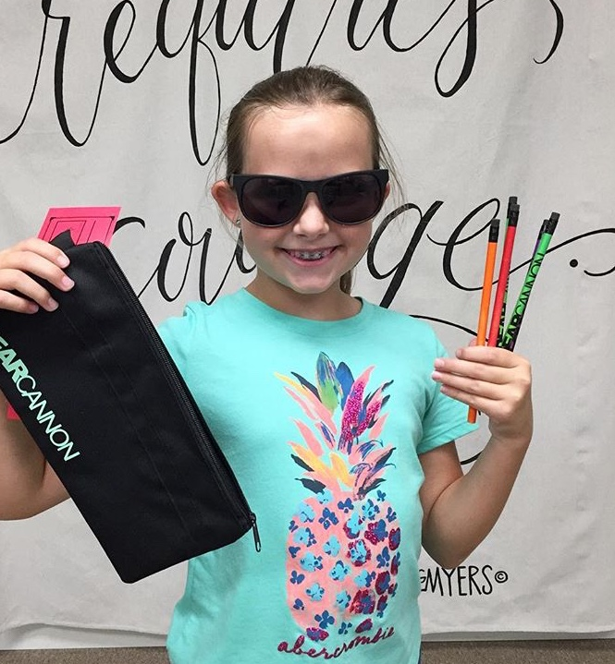

Slide 13
Building an audience
What is a hashtag?
Artteacher
Artteacherlife
Arteducation
Artteachersofinstagram
Elementaryart
Classroom
Notes:
Blogging with your own website and YouTube you have to build your own audience (Promoting your page on another social media site)
Hashtags- Help to build your audience by putting your information in folders, and people can follow the folder. (cut and paste from your notes on your phone)
Hashtags- Tag a company whose products you use, they might share your photo and that will help build your audience.
Who do you want your audience to be?

Slide 14
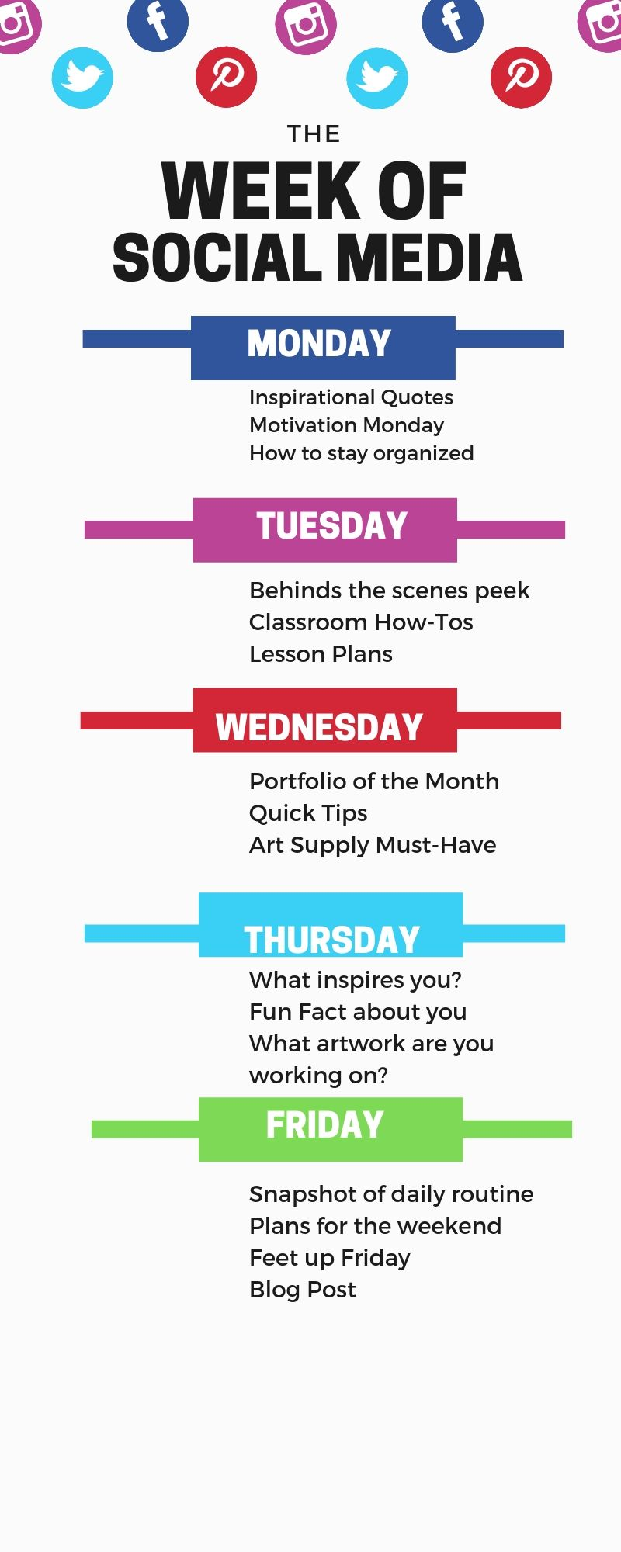
What to Post?
Notes:
Schedule when you post something- once a week or every other day
When you build up to it, there are apps that schedule when you post something, but for now make yourself a schedule or calendar
What time of day you post- think about when you look at social media.

Slide 16
Be a good advocate
Notes:
Shareable
Turn it on public not private so others can find you.
Take tons of photos so you can edit and pick just the best ones to post.
Professional and Joyful at all times?
Advocacy is about educating and informing elected officials, the public, and the media about the importance of art in our society.
It is up to us, the artists! Who better to talk about arts transforming power than those of us that have had our life transformed by art.

Slide 17
Be a Good Advocate on Social Media
Promote the art and art events in your local community
Highlight your students’ art within the school
Talk about legislation that effects your discipline
Give resources to help empower others

Slide 18
Take a break
Social Media is the highlight reel of people’s life it is not the reality.
Nobody’s 24/7 day looks as glorious as an Instagram day.
If you start comparing yourself to what you are seeing on social media, and are experiencing frustration instead of inspiration it is time for a break.
The truth is social media will be there when you get done with a little break or breathing room. I have a friend who said, “If it didn’t happen on FB it didn’t happen” That is not true. Lots of things happen in the real world and there are no videos, pictures, or life changing posts.

Slide 19
Charity-Mika Woodard Pittsburg State University Instagram: charitymika Website: www.charitymika.com YouTube: Charity-Mika Woodard Facebook: Charity-Mika Woodard

